Slide 1

HW11 Documentation

Slide 2
void intToBinary(int num, char *binary, int binarySize) {
int i;
for (i = binarySize - 1; i >= 0; i--) {
binary[i] = (num % 2) + '0';
num /= 2;
}
binary[binarySize] = '\0';
}
Define a function that can transform decimal into binary.

Slide 3
int power(int m, int n){
int result = 1;
for (int i = 0; i < n; i++){
result *= m;
}
return result;
}
Write a function ’ power ’ to compute m ^ n

Slide 4
char DATA[100000][100] = {};
int LENGTH = -1;
Declare two global variables, 2D array “DATA” and integer “LENGH” to store the data and the record length

Slide 5
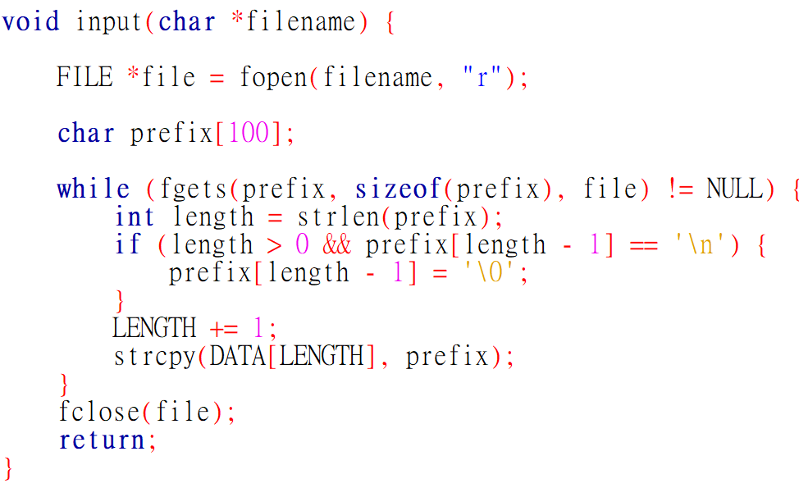
Define an input function with the filename parameter, and then read the data in the file by “fgets”, after the reading, program will store the data in 2D array DATA.

Slide 6
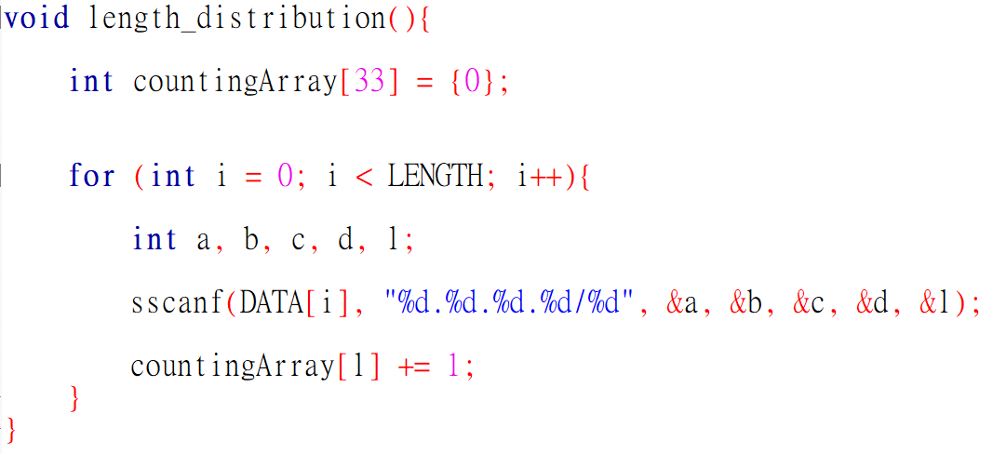
Define a length_distribution function. Create an array to store the number of prefixes with prefix length. Collect the length by the format input and store the data into the array.

Slide 7
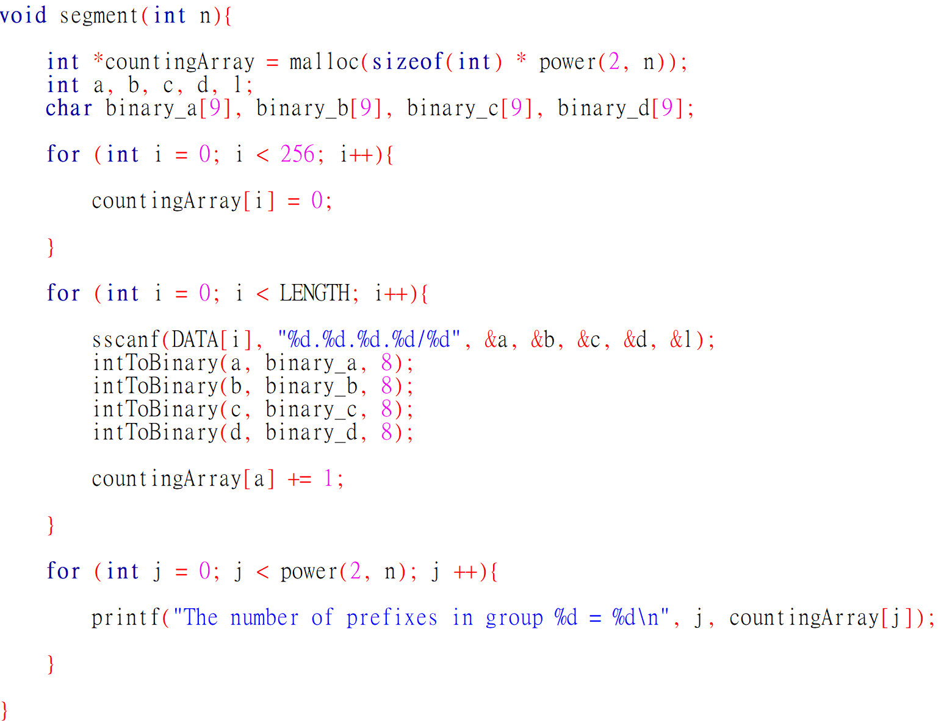
Define a segment function with n. Construct a array and initialize it in order to statistic the number of prefixes in different group.

Slide 8
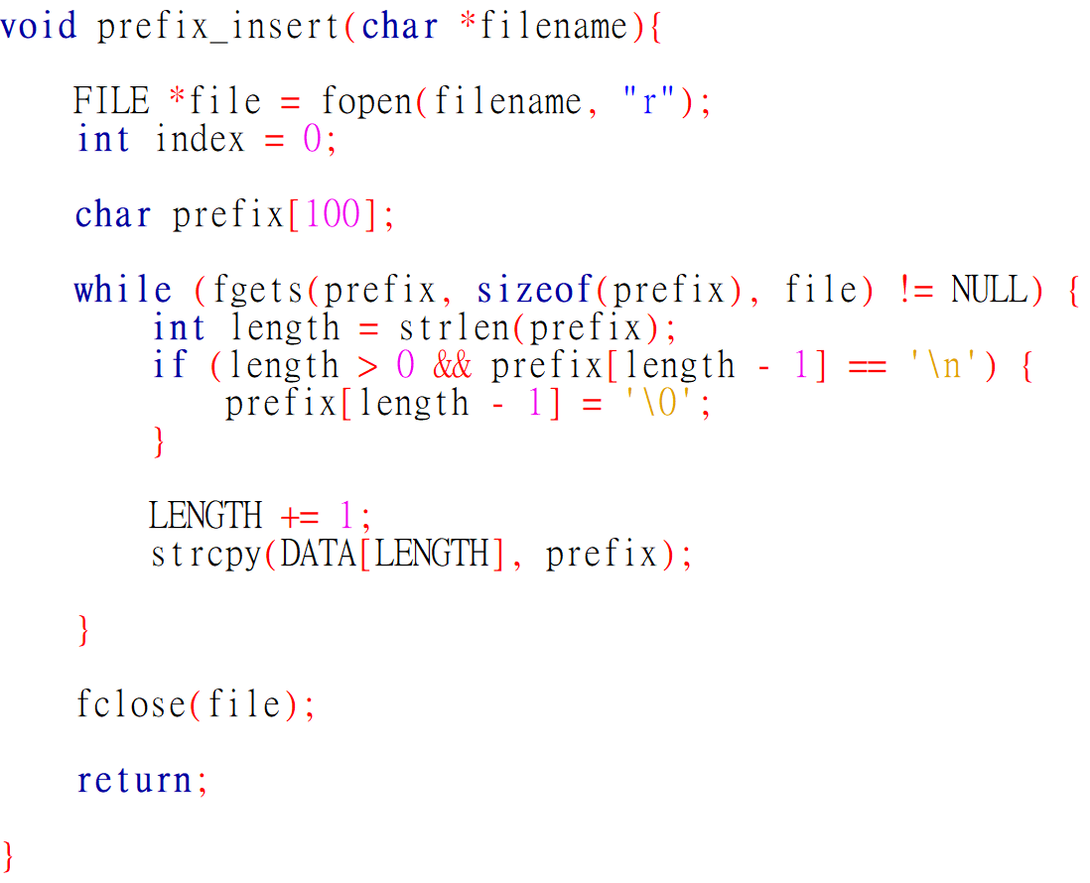
Define a prefix_insert function with the filename parameter, and then read the data in the file by “fgets”, after the reading, program will store the data in 2D array DATA.

Slide 9
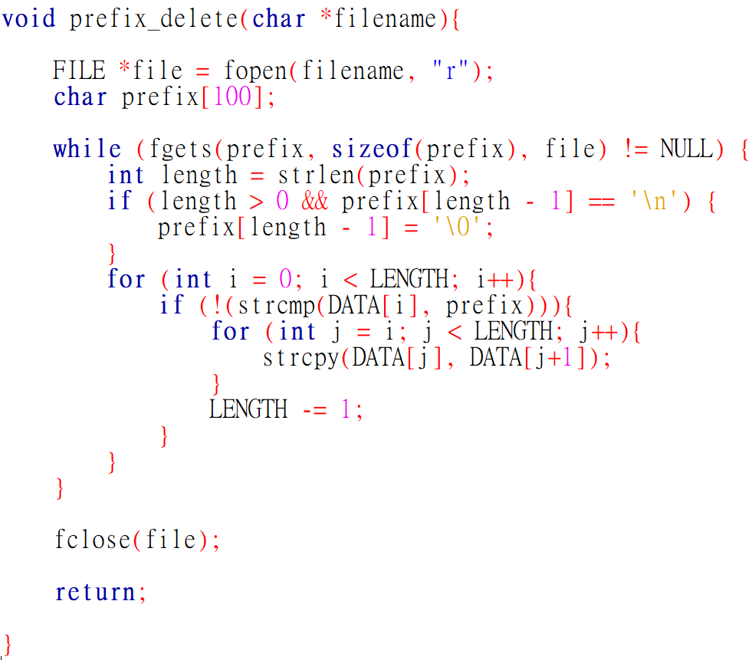
Define a prefix_delete function with with the filename parameter. Compare and delete the data if there were the same string in the deleting file.

Slide 10
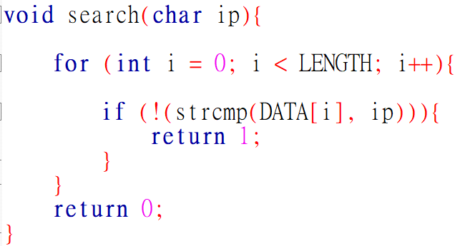
Define a search function with with the ip parameter. Travel the whole data set and return 1 if there were a same string, otherwise return 0.

Slide 11
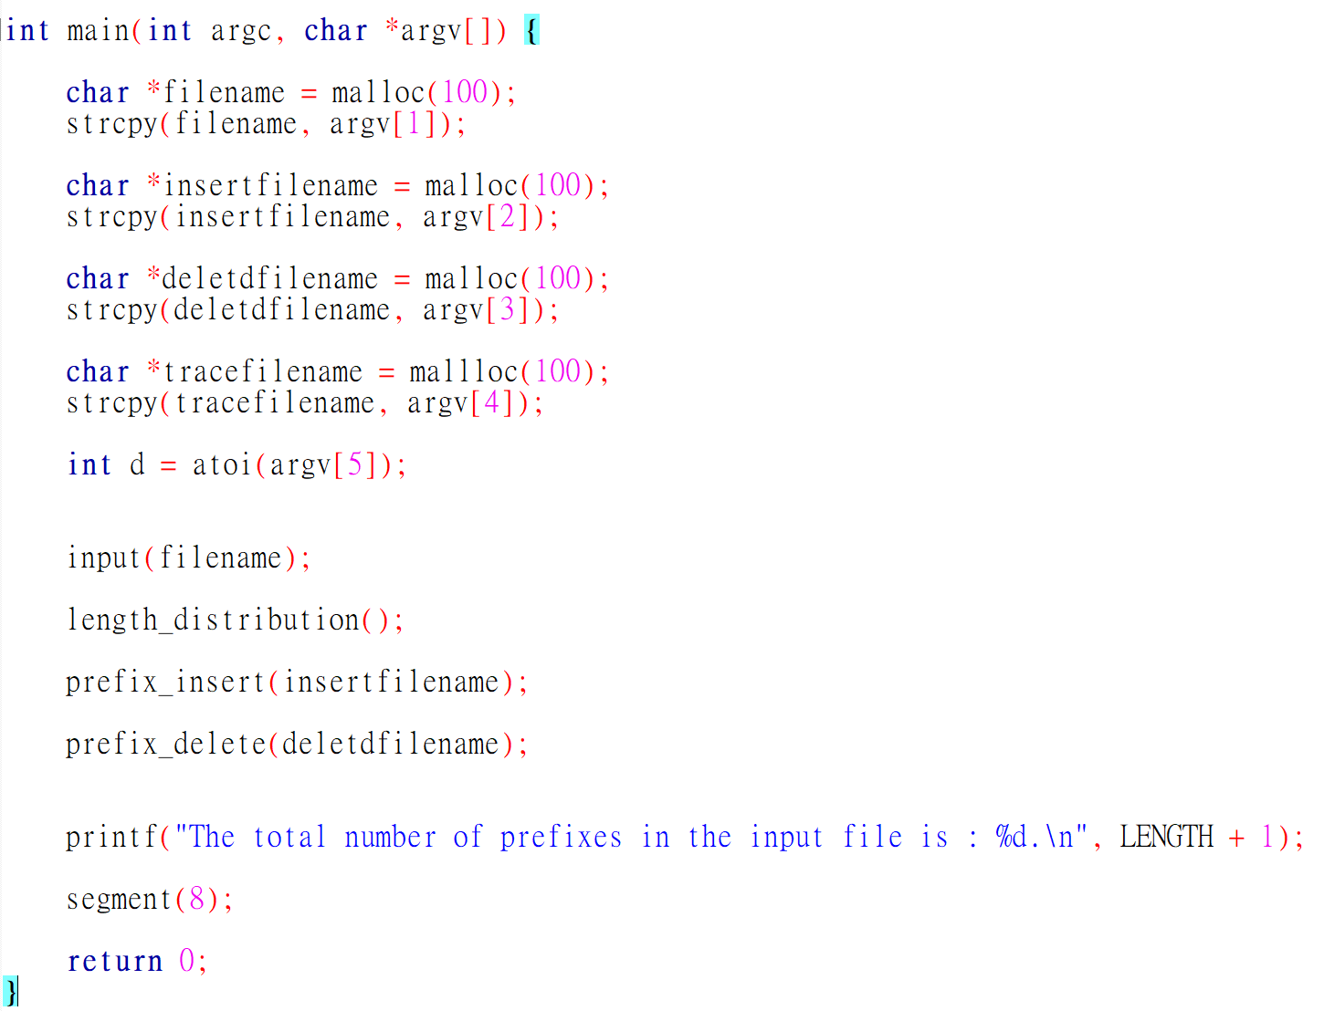
In the main function, we call all the function we wrote in the previous with the parameters in the “*argv[]”

